Slide 1
16. GITHUB REPOSITORIES

Slide 2
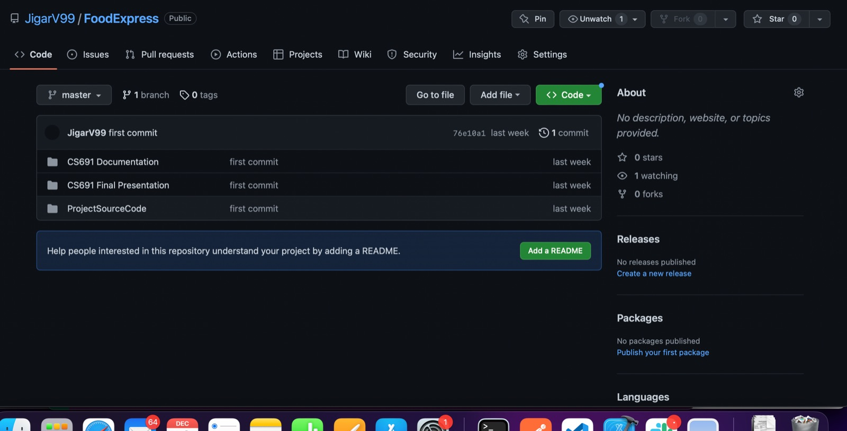
https://github.com/JigarV99/FoodExpress/tree/master

Slide 3
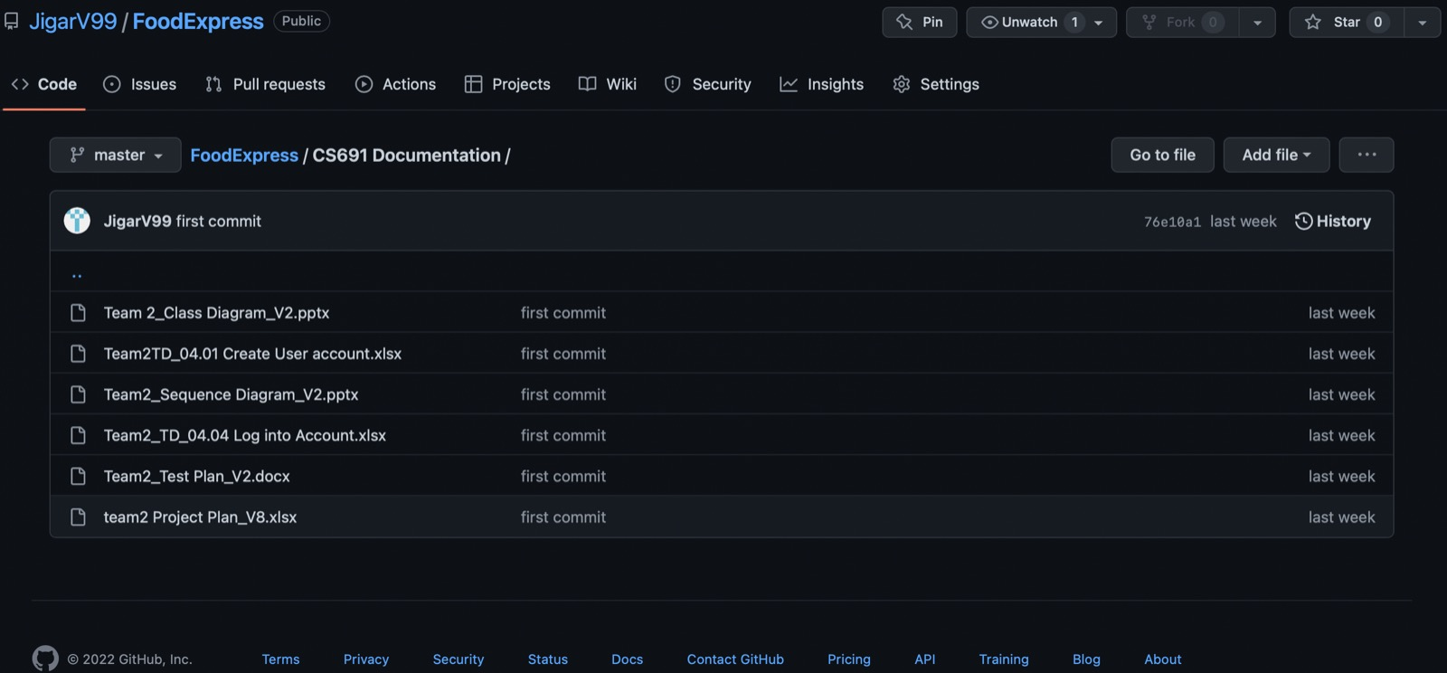

Slide 4
